Slide 1
2021-2022 Course Descriptions
John Swett High School

Slide 2
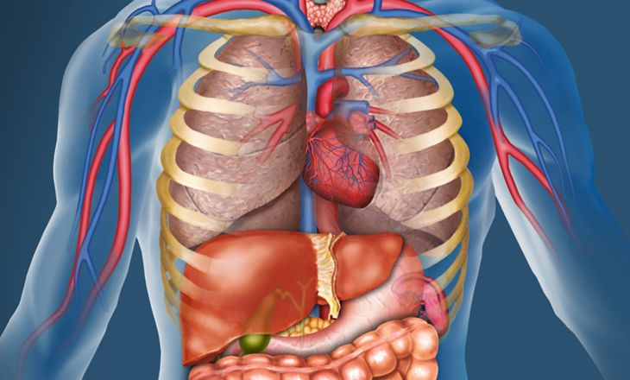
Anatomy & Physiology (Honors)
Grades 11 & 12; Fulfills UC/CSU - D (laboratory science) and JSHS Career Prep requirement
Who should take A & P? Have you ever wanted to know the names of the muscles? How our brain communicates with our bodies? How diseases like cancer or sickle cell anemia affect our bodies and can be treated or cured? Are you interested in a career/major in Health Care or Biological Sciences or are you curious about the human body? Then A&P is for you!
This course involves:
Fast-paced, challenging learning
Labs to understand YOUR body
Real world applications
Creative & collaborative activities
Stories from Ms. Harris’ time as an EMT
If you have questions email Ms. Harris: rharris@jsusd.org

Slide 3
AP Psychology
Grades 11-12
The AP Psychology course introduces students to the systematic and scientific study of human behavior and mental processes. While considering the psychologists and studies that have shaped the field, students explore and apply psychological theories, key concepts and phenomena associated with such topics as the biological basis of behavior, sensation and perception, learning and cognition, motivation, developmental psychology, testing and individual differences, treatments of psychological disorders, and social psychology. Throughout the course, students employ psychological research methods, including ethical considerations, as they use the scientific method, evaluate claims and evidence, and effectively communicate ideas.
The AP Psychology course is designed to be the equivalent of the Introduction to Psychology course usually taken during the first college year.
There are no prerequisites for AP Psychology. Students should understand that there is a great deal of reading and writing involved in the course.

Slide 4
Advanced Placement United States History (APUSH)
AP United States History is an introductory college-level United States history course. Students cultivate their understanding of United States history from c. 1491 CE to the present through analyzing historical sources and learning to make connections and craft historical arguments as they explore concepts like American and national identity; work, exchange, and technology; geography and the environment; migration and settlement; politics and power; America in the world; American and regional culture and social structures.
AP United States History is the equivalent of the introductory United States History course which students would typically take in their first year of college.
There are no prerequisites for AP United States History. Students should be aware that there is a substantial amount of reading and argumentative writing required.

Slide 5
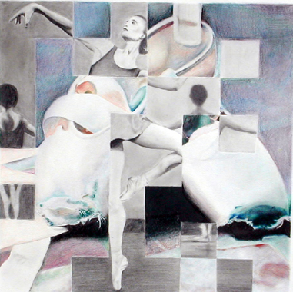
Art 1, Art 2
ART 1
Are you interested in learning how to draw, paint, and create art? An entire year of creative expression through art, this class offers a variety of materials and opportunities to try new techniques. Art 1 focuses on the elements and principles of design, and is designed to make art exciting, easy to learn, and accessible to students of all skill levels!
This course is a prerequisite for Art 2.
Grades: 9, 10, 11, 12 Year UC/CSU - f
ART 2
Prerequisite: Art 1 with teacher approval, OR a teacher approved portfolio.
This class is for those students who know they possess the “creative gene!” Picking up the pencil, brush, and tools where Art 1 left off, Art 2 is the intermediate 2-dimensional class with a more in-depth journey down the creative path. Art 2 focuses on developing the ideas behind the artwork, and in learning new and exciting techniques. Sign up today!
Grades: 10, 11, 12 Year UC/CSU - f

Slide 6
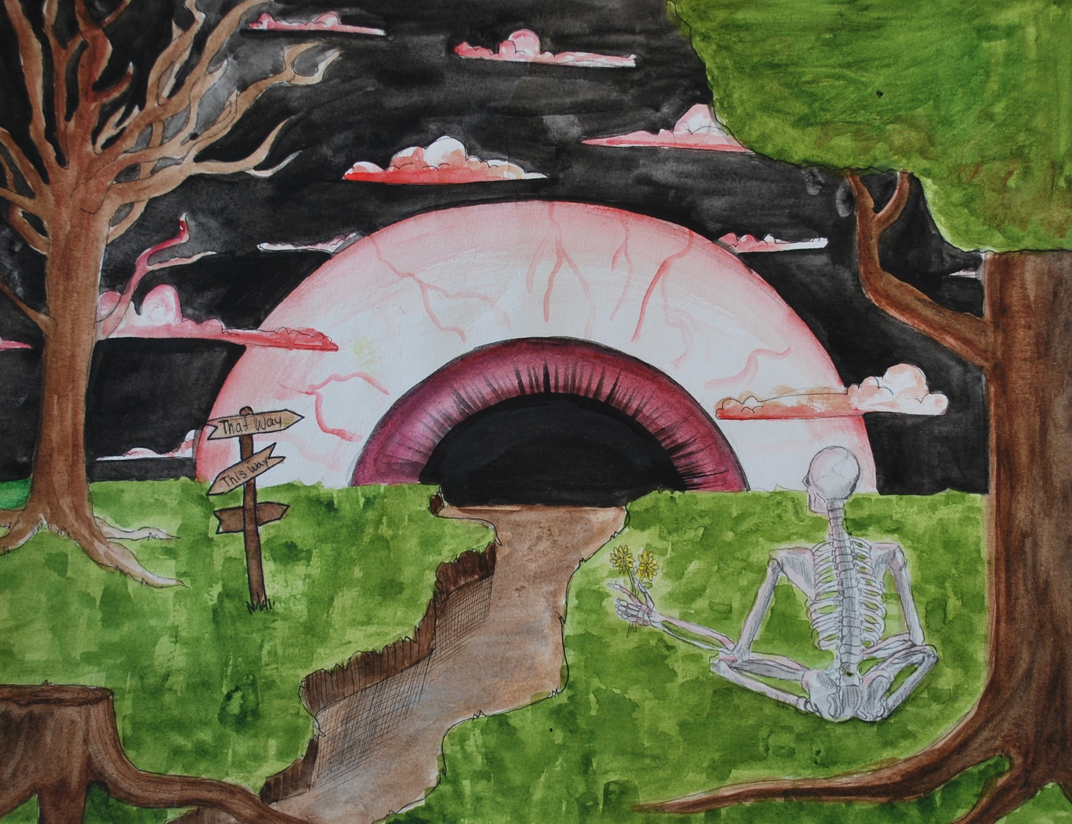
AP Art & Design (Porfolio)
AP Art & Design (Advanced)
Prerequisite: Art 2 with teacher approval, OR a teacher approved portfolio. All interested students will need to submit a slideshow of their five top pieces with an artist statement.
You are an amazing artist and you know it! AP Art & Design is a division of the AP Portfolio with a focus on 2D techniques such as drawing and painting. The class is dedicated to the creation of a portfolio through specific areas of study. Interested students should have a love of creativity, solid design concepts, and currently be at an intermediate level of art. For more information: https://apstudents.collegeboard.org/art-design-program
Grades: 10, 11, 12 Year UC/CSU - f

Slide 7
AVID
AVID (Advancement Via Individual Determination)
AVID (9-10) The AVID course is an elective class for students who are college-bound. The AVID curriculum focuses on writing, inquiry, collaboration, organization, and reading (WICOR) through the AVID High School curriculum. While concurrently enrolled in a college-prep course of study, students learn strategies to enhance success. Note-taking, outlining, writing, speaking, reading, test-taking strategies, and self-awareness are stressed. In addition, the course includes college motivational activities and intensive preparation for ACT, SAT I and SAT II.
AVID (11-12) The AVID Seminar for the junior and senior years prepares students for entrance into four-year colleges by emphasizing analytical writing, preparation for college entrance and placement exams, college study skills, oral language development, note taking, and research. Seminar students are expected to participate in, and eventually act as moderators for, Socratic Seminars. In addition, students are required to make oral presentations to the class on topics related to career searches, contemporary issues, and social concerns, all the while focusing on a culminating senior paper, portfolio, and/or project.

Slide 8
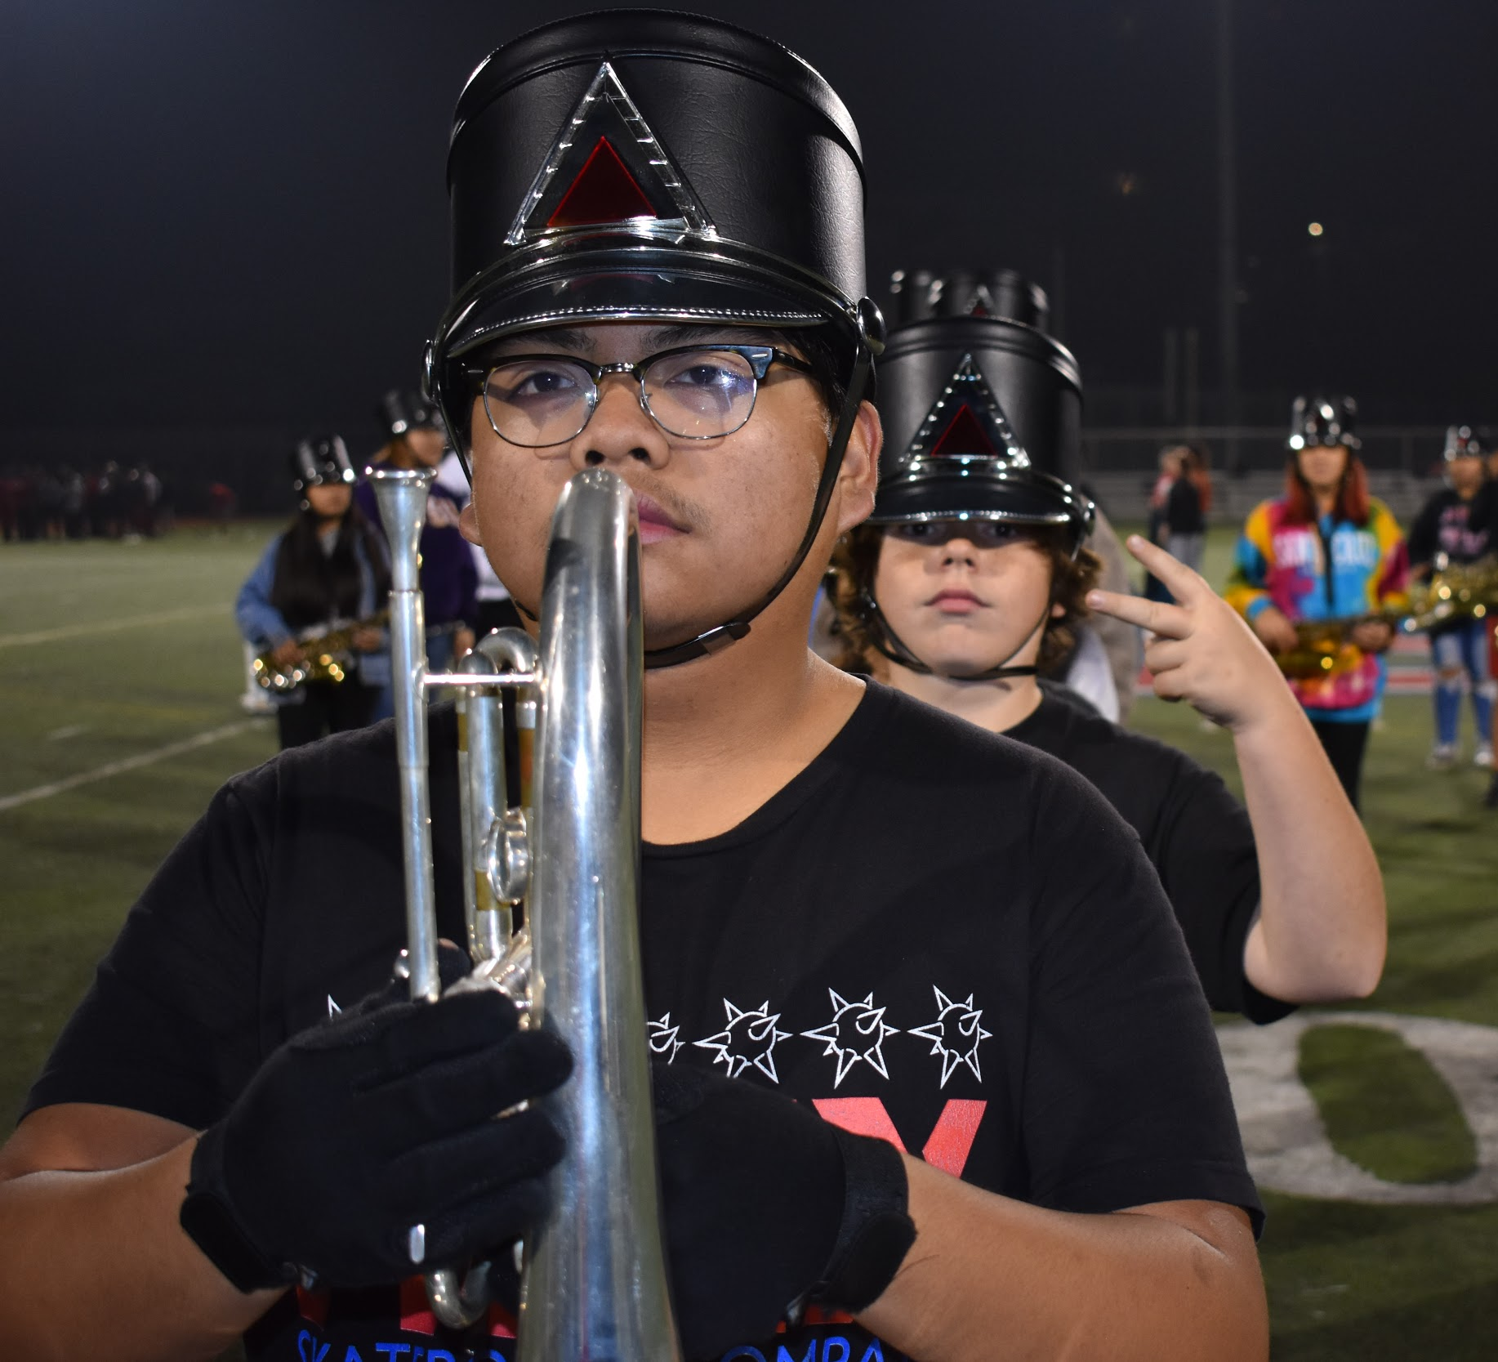
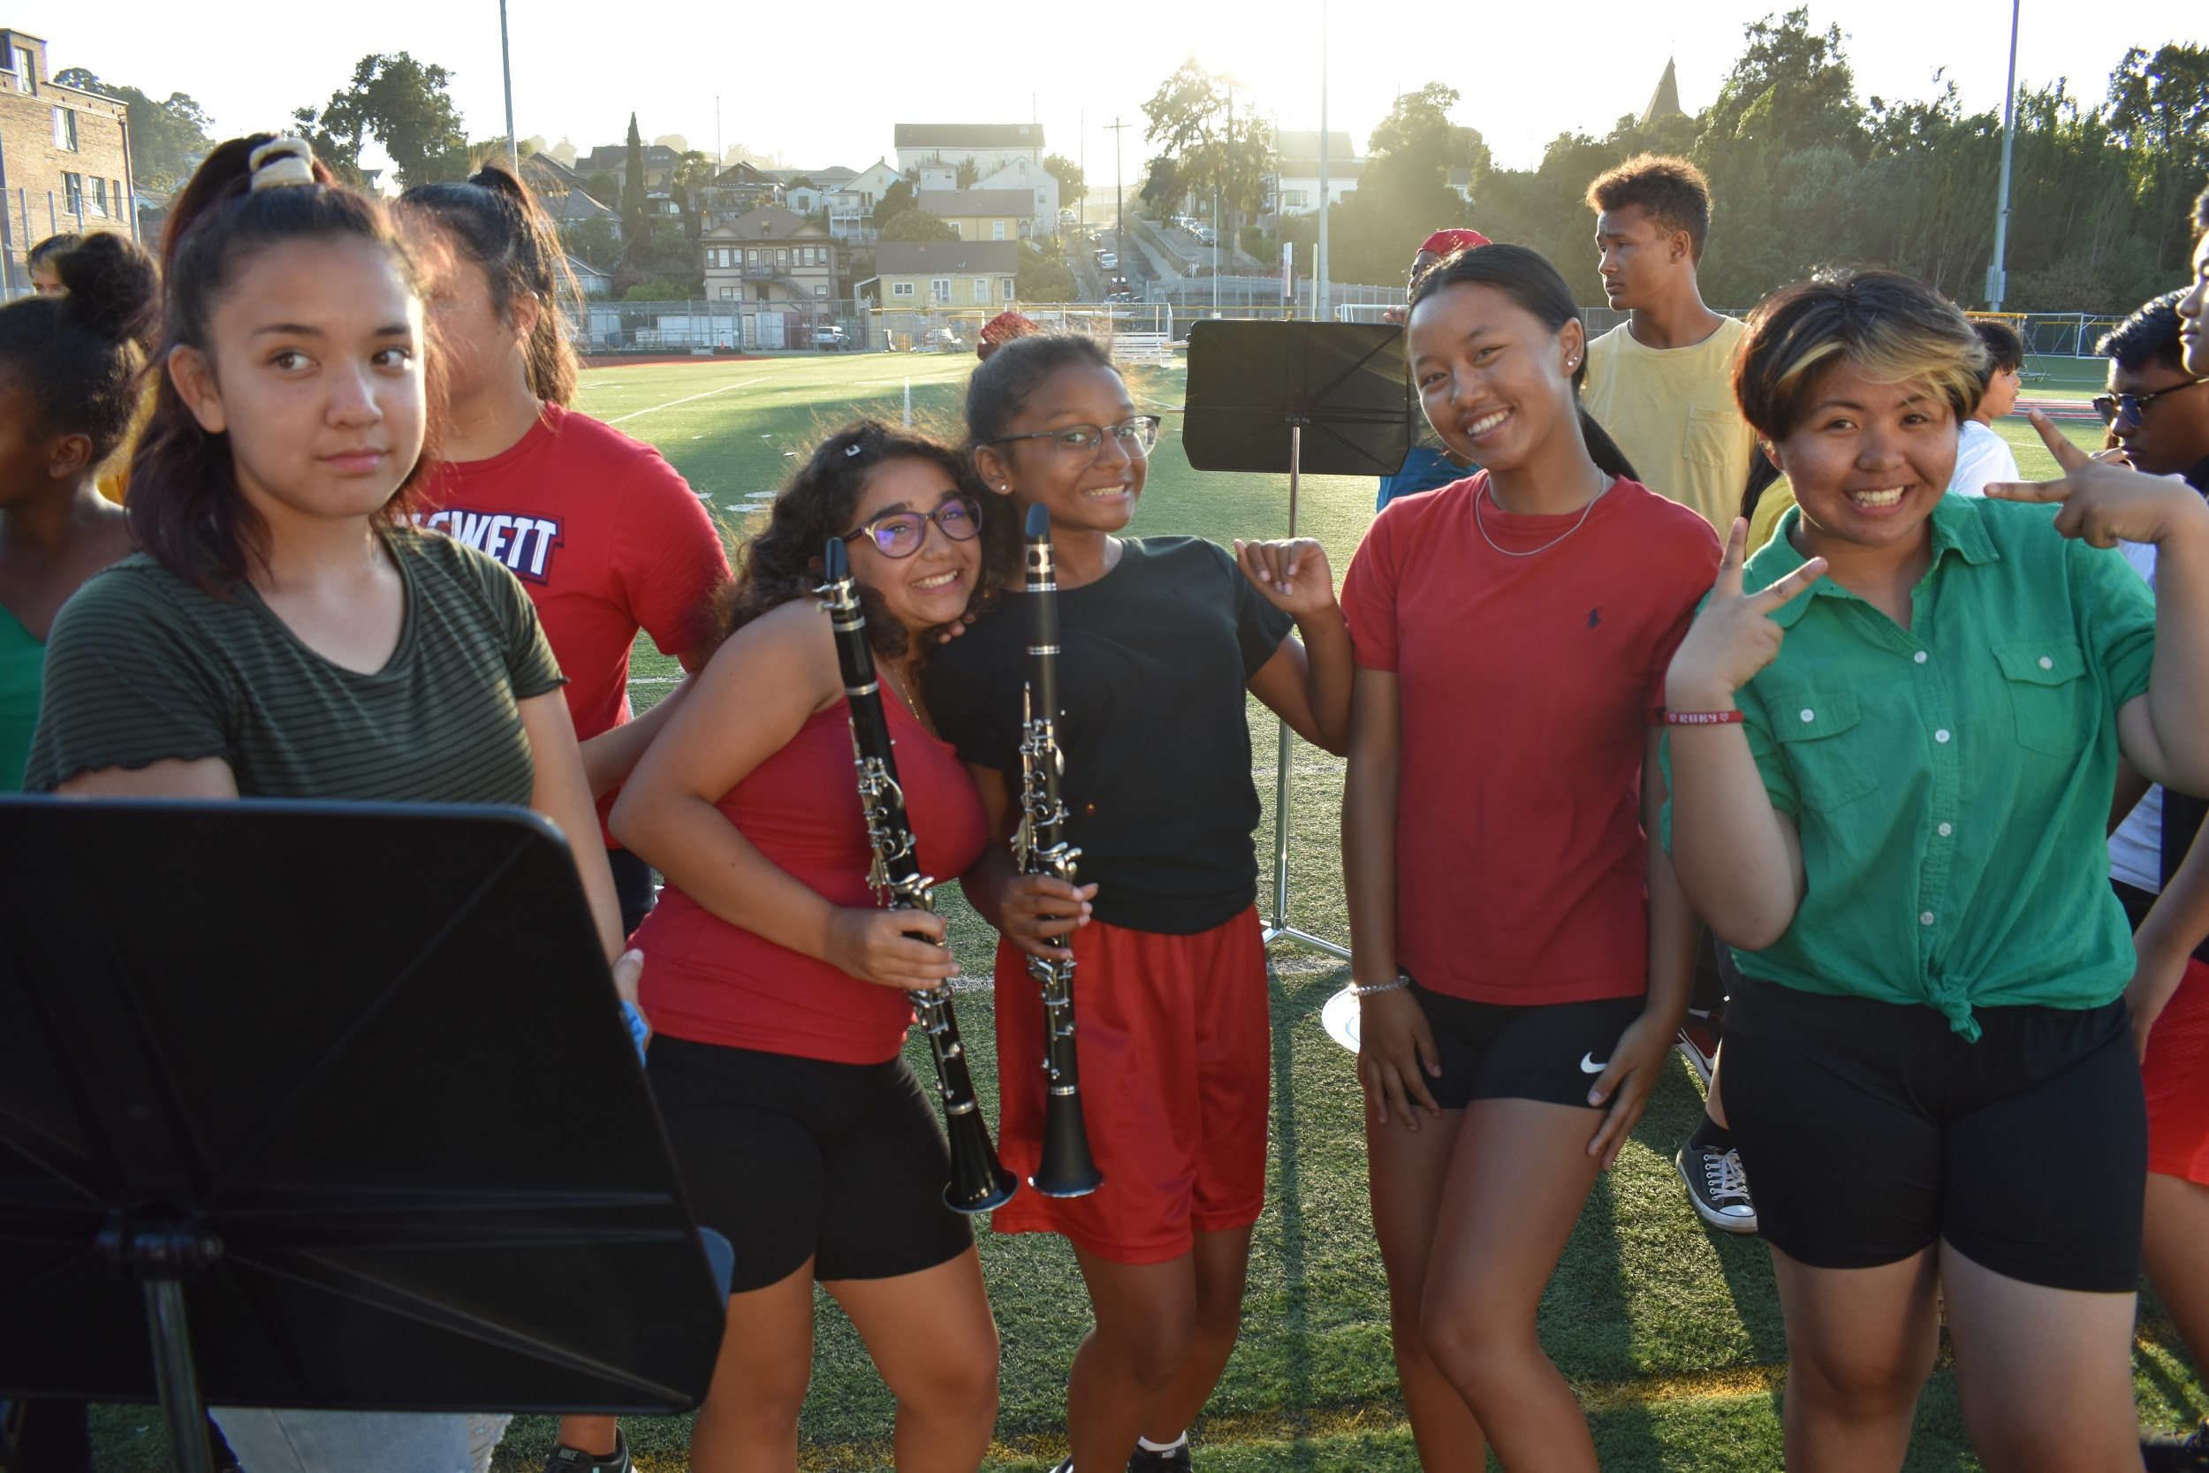
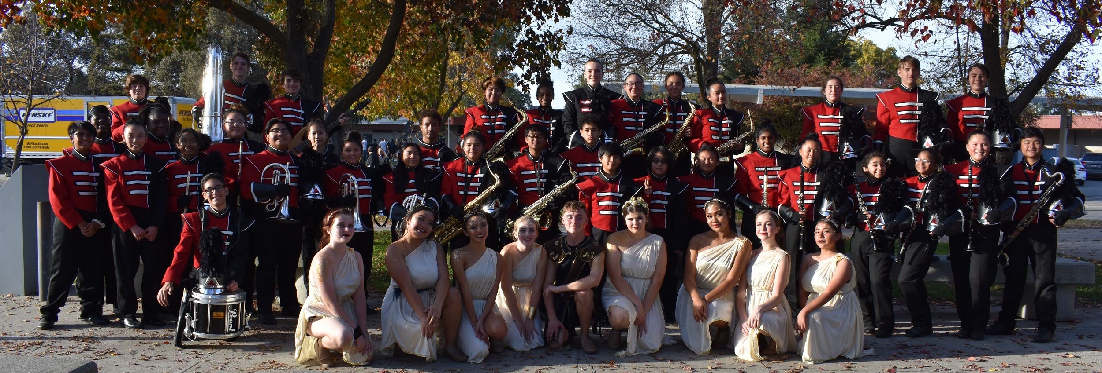
Band, Grades 9 - 12
Be a part of the award winning John Swett High School Band! Develop your artistic abilities, musical knowledge, and instrumental skill alongside your friends and peers of all ages. Be part of an activity that you will remember for the rest of your life. Rehearse, travel, compete, perform, and enjoy your time with the friends whom you begin to know as your family. While experience in any musical instrument is preferred, it is not necessary.; we can teach you one or even two. What is necessary is a good work ethic, determination, and a growth mindset to succeed.
Other Notes:
During the fall, there are evening rehearsals, weekend competitions, performances away and at home, and a two week band camp before school begins.
Participation in the fall marching band counts as one semester of PE credit.
University A-G Requirements: Category F
For additional information, please contact Mr. Cadiz at: FCadiz@jsusd.org

Slide 9
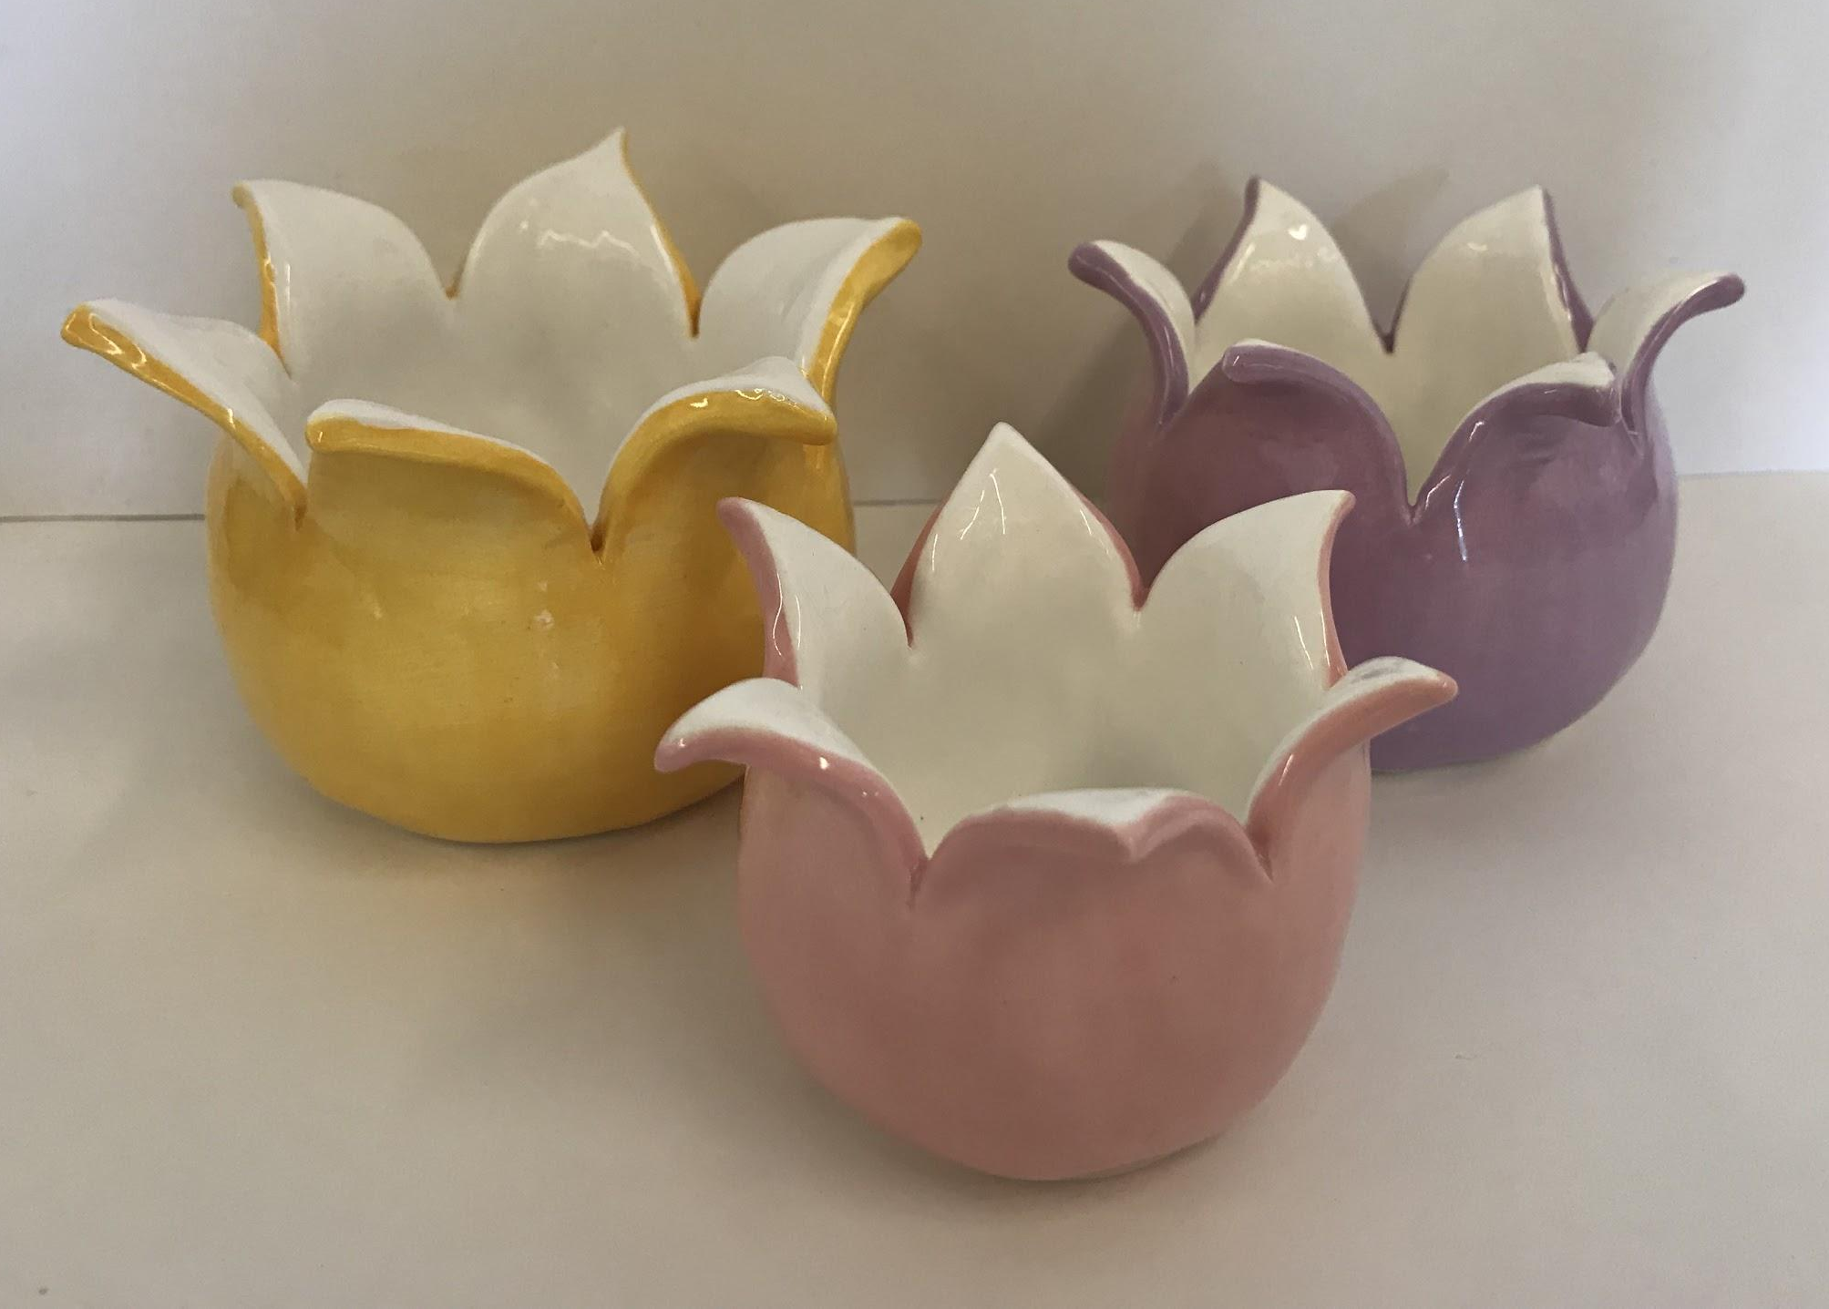
Ceramics
Ceramics/Mixed Media
If you like hands-on projects, have a sense of adventure, and enjoy creating art from different materials, sculpture is for you!
Ceramics/Mixed Media is an introduction to 3-dimensional art, and is designed to make sculpture exciting, easy to learn, and accessible to students of all skill levels! The class focuses on using the elements and principles of design to teach students the fundamentals of art. Roll up your sleeves and sign up today!
Grades: 9, 10, 11, 12 Year UC/CSU – f

Slide 10
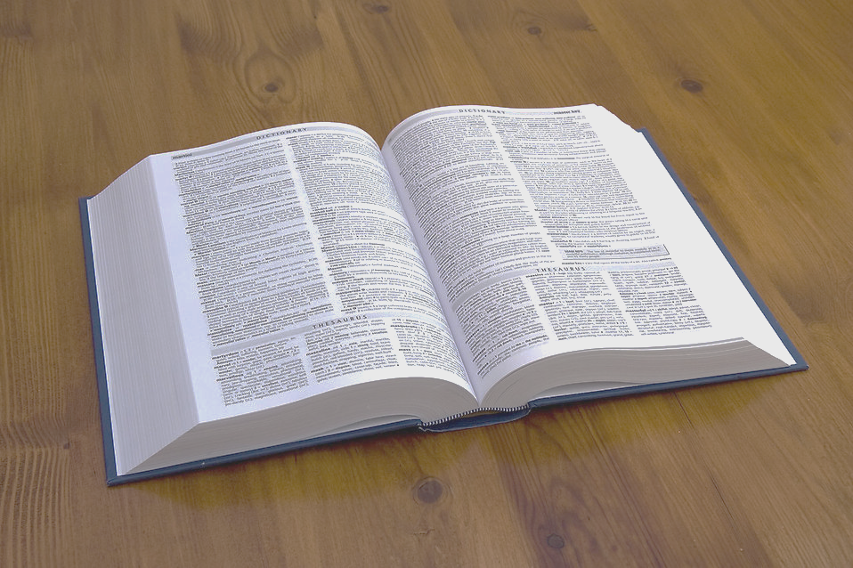
English -Advanced/AP
All advanced English courses are designed to help you acquire the academic experiences and skills necessary for success in your college work. The courses include literature-based extensive reading and writing assignments with the goal in mind to challenge you to improve your ability to think clearly and communicate effectively. Although there is no prerequisite, ideal candidates will have earned an A or B in previous English courses and have a passion for reading.
The AP English Language & Composition course focuses on the development and revision of evidence-based analytic and argumentative writing, the rhetorical analysis of nonfiction texts, and the decisions writers make as they compose and revise. Students evaluate, synthesize, and cite research to support their arguments.
The AP English Literature & Composition course focuses on reading, analyzing, and writing about imaginative literature (fiction, poetry, drama.) Students engage in close reading and critical analysis of imaginative literature to deepen their understanding of the ways writers use language to provide both meaning and pleasure. Writing assignments include expository, analytical, and argumentative essays that require students to analyze and interpret literary works.

Slide 11
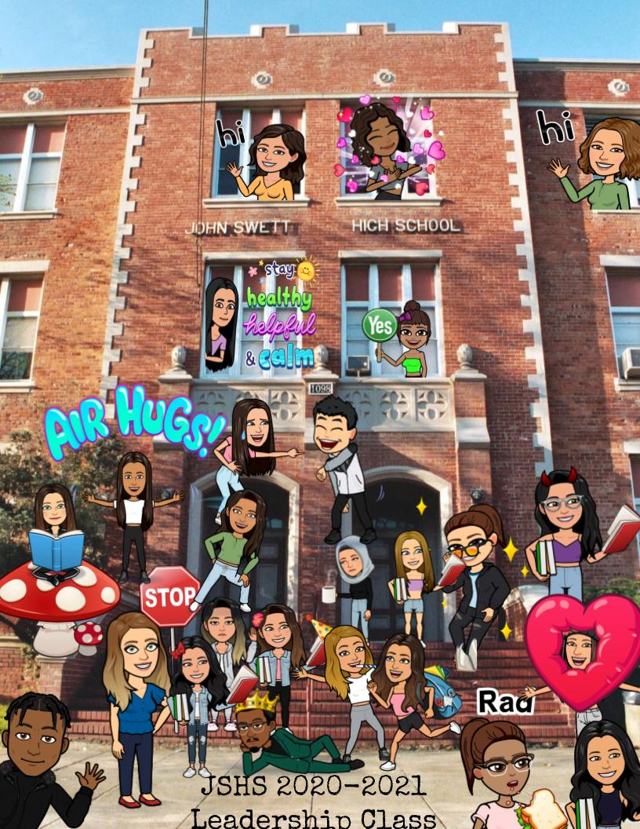
Leadership
Student Council/ASB (Associated Student Body)
This is a required course for elected student body officers, class officers and appointed officers.
Students coming into John Swett High School as freshmen may apply in the spring. After an interview, students will be selected for Freshmen Class office positions.
This class provides the forum for student body and committee meetings, and for the planning of all school activities that take place during the school year.
Grades: 9 - 12 Year

Slide 12
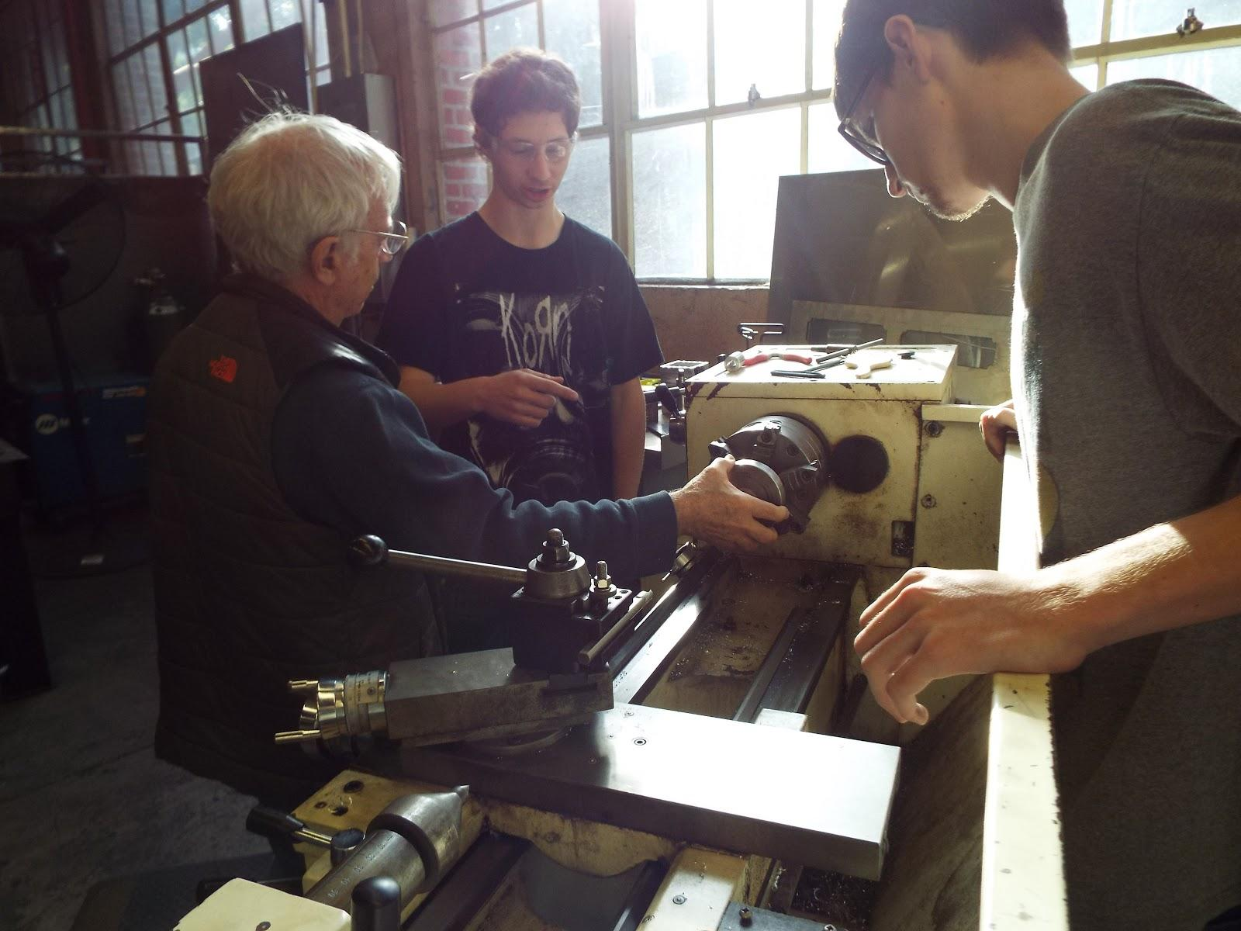
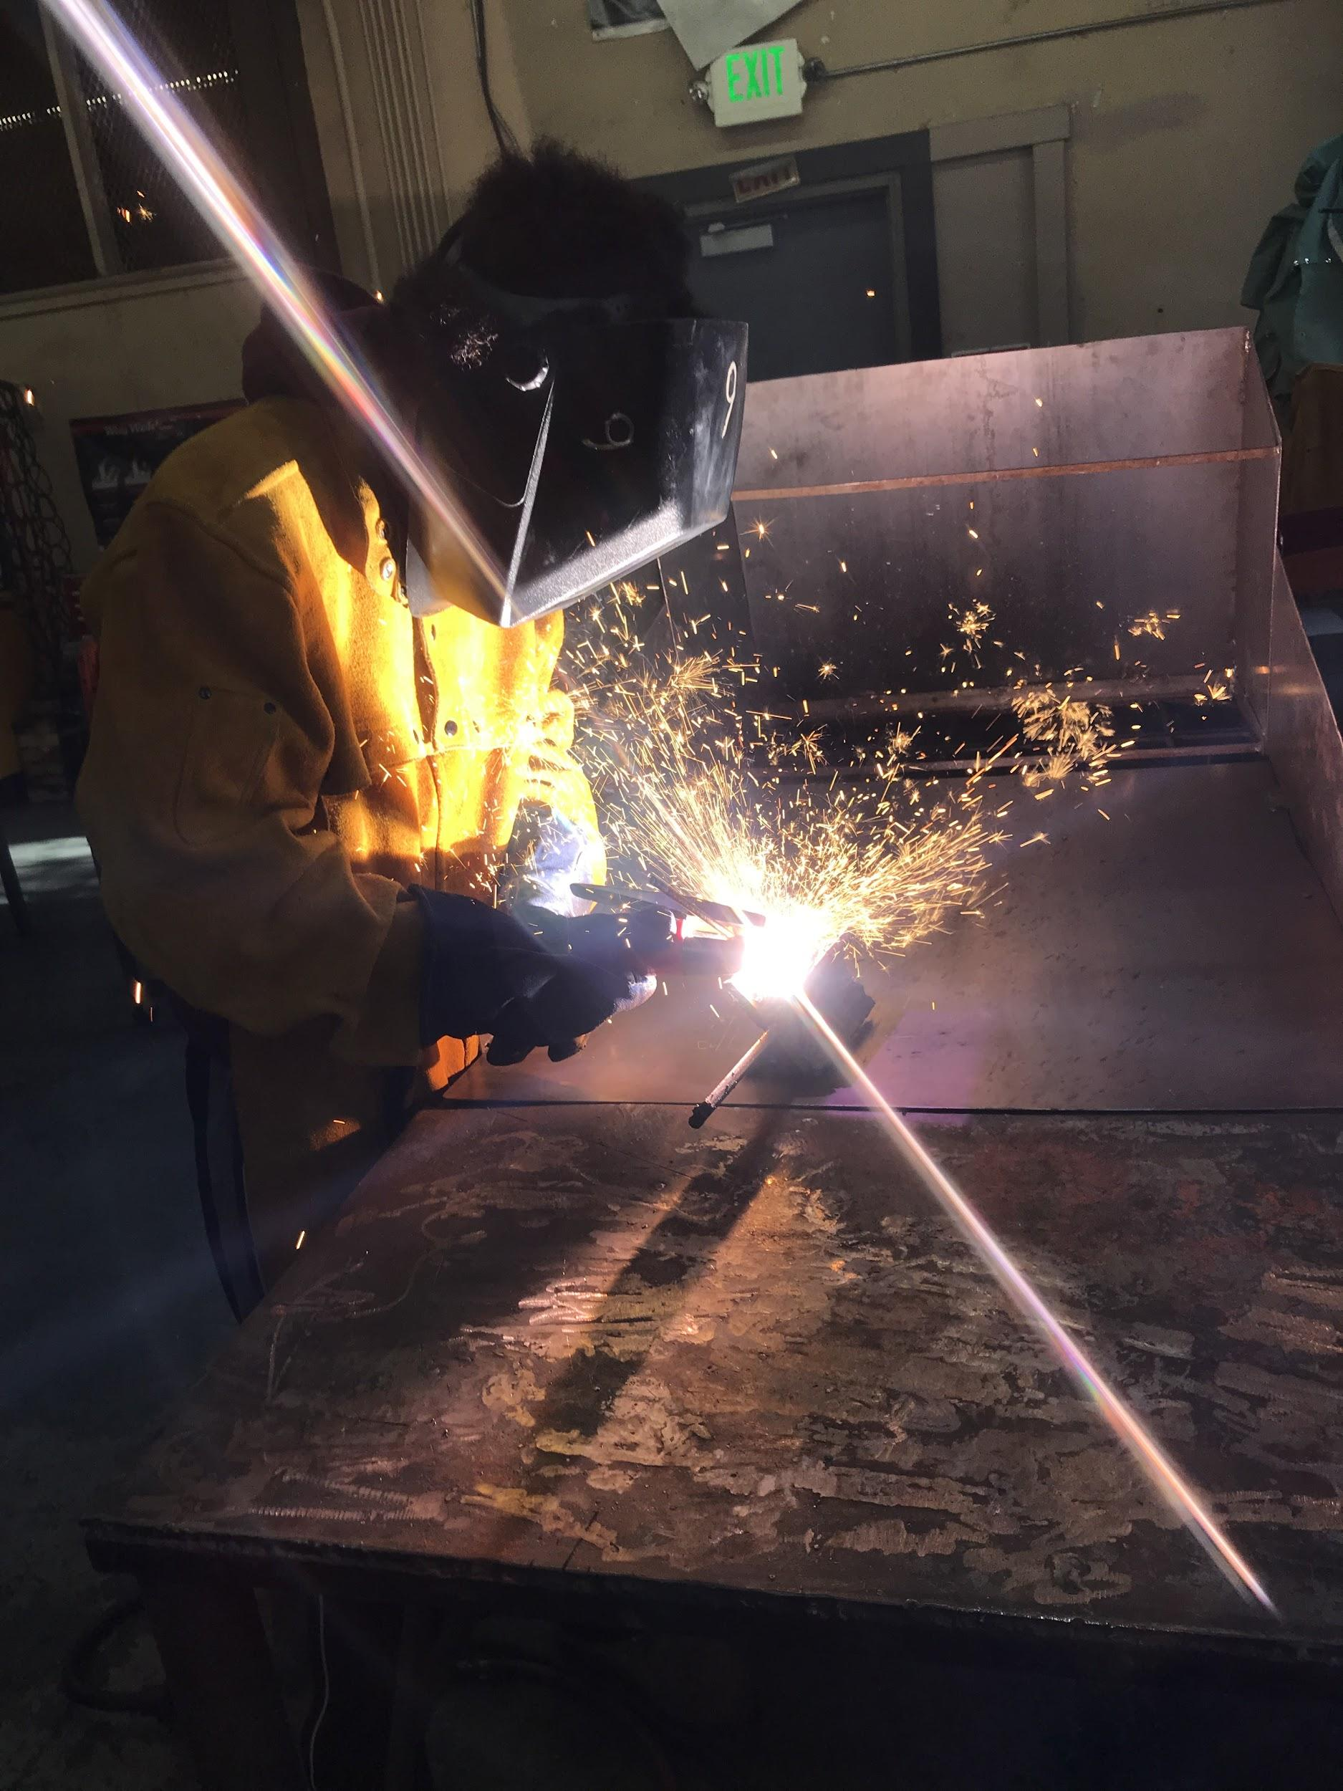
Manufacturing
Grades 9-12
The class is an introduction to the world of manufacturing. Lectures include Industrial Safety and Health, Materials and Processes of Manufacturing, and Employability Skills.
Hands-on activities include:
Safe use of power hand tools
Computer Aided Design, where you learn to use the software of industrial design
Welding, where you learn different types of welding processes, and practice the art of joining metals together.
Machining, where you learn to cut metals using stationary machine tools, as well as precision measuring equipment.

Slide 13
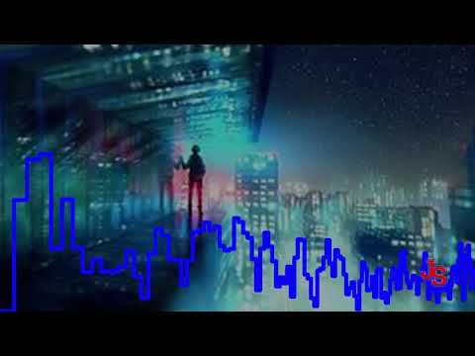
Music
Grades 9-12
Learn the basics of music production and music theory in this year long course. We will discuss and create personal projects through MIDI, music effects, loops, sampling, and other tools in a Digital Audio Workstation. While we will explore the practice of some live instruments, it will not be the focus of this class. This course does not require any previous knowledge; however, access to a personal computer, phone, or tablet is strongly preferred.
Produced by Ralph Andre Ramos (11)
Produced by Nathan Jalal (12)
Produced by Aiden Luu (9)

Slide 14
Physics

Slide 15
ROP Electrical Engineering
Grades 11-12
Electrical engineering deals with everything electrical/electronic. Starting with power generation through analog , digital circuits and audio amplifiers. 1st quarter is DC theory, 2nd quarter is using electronic test equipment and the analysis of electronic circuits, third quarter is AC theory and 4th quarter we build stuff everyday.
THIS CLASS IS FUN!!! ( counts as UC subject g)
Concurrent enrollment in algebra 2 or higher is encouraged.
Students are encouraged to take this class before or with physics. The two classes are an excellent team.

Slide 16
ROP CADD (Computer Drafting and Design)
Grades 11-12
Everything you see around you that is man-made in industry, has been designed before it was manufactured. Almost all design activities today use 3D design software.
In the CAD class we learn how to use this same industrial-strength 3D software to create parts and assemblies of parts. This is done through a collection of graded tutorials that teach the process, step by step. The course may be repeated for credit.
Anyone wishing to go on to any kind of engineering will be way ahead of their college classmates if they have taken this course.

Slide 17
ROP Computer Science
Grades 11-12

Slide 18
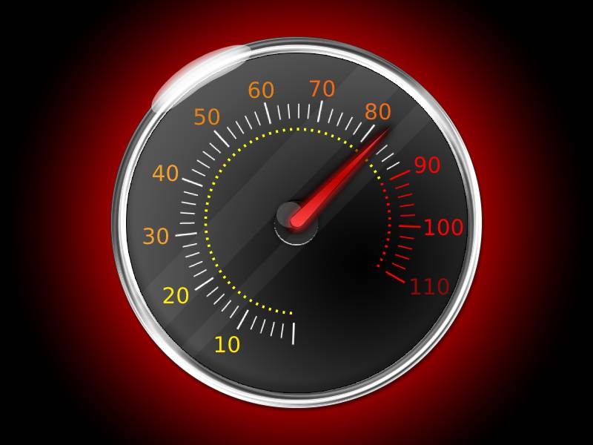
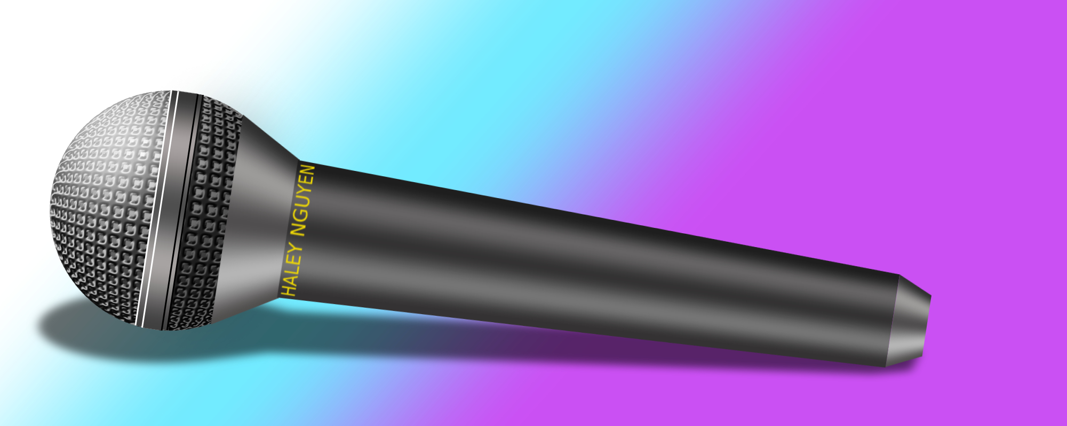
ROP Multimedia
ROP Multimedia is a year-long class that introduces students to creating graphics such as these in Adobe Photoshop.
Skills and techniques learned in ROP Multimedia can be gateways to careers in graphic arts, motion pictures, video game creation, advertising, and marketing.
Students will also learn techniques in photo manipulation and layout design.

Slide 19
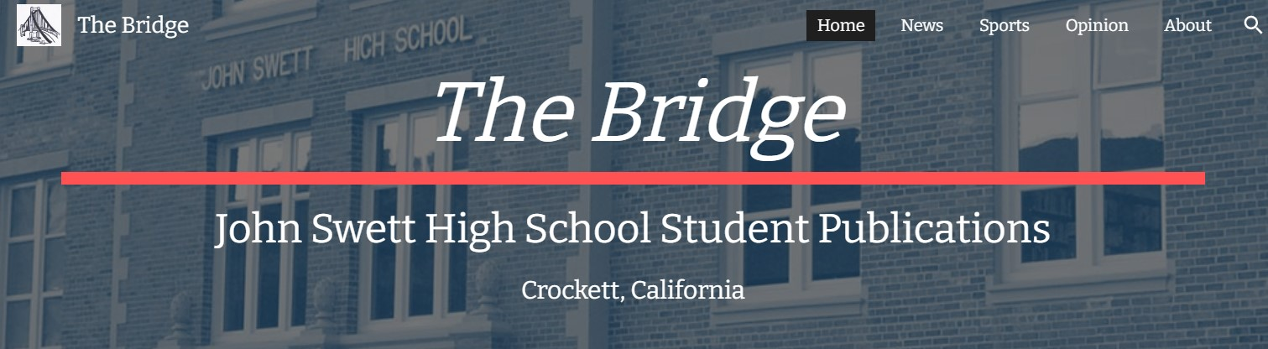
ROP Publications/Journalism
Grades 11-12
This competency-based course prepares students for entry-level positions in desktop publishing. Students use web-based tools to create multimedia publications. The Publications class at JSHS produces the school’s web-based newspaper (The Bridge) and yearbook (The Warrior) Page design, layout, survey creation and design, proper use of graphics, professional and technical writing, digital arts, and portfolio preparation are also included. Integrated throughout the course are career technical education standards which include basic academic skills, communication, career planning, technology, problem solving, safety, responsibility, ethics, teamwork, and technical knowledge. (ROP course of study revised June 2016)

Slide 20
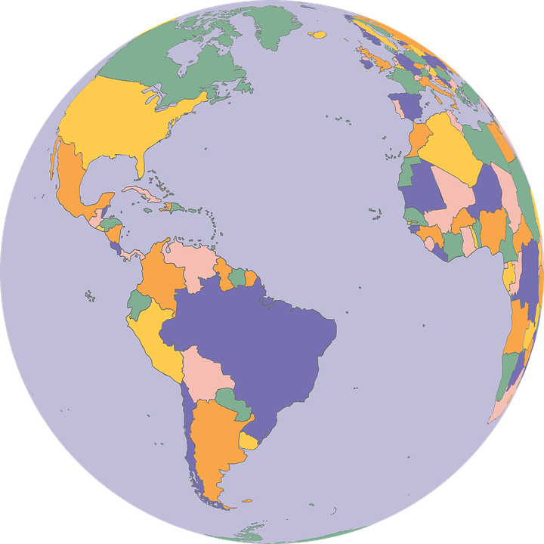
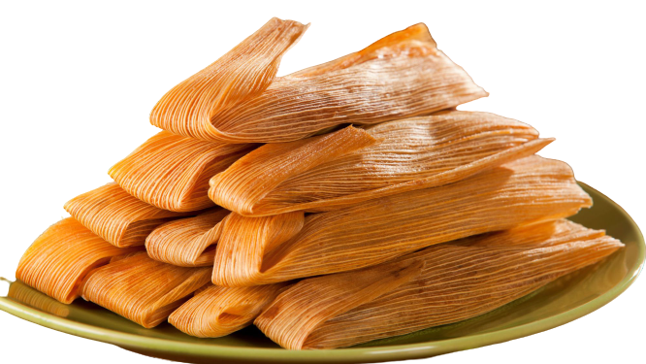
Spanish
Spanish 1, Spanish 2, Spanish 3 & Spanish 4H
Grades: 9 - 12
University A-G requirement: category E
Join the fun en la clase de español and learn more about the world around you! In each level of Spanish students study the language through familiar topics, such as music, art, sports, pastimes, school, food, health, friendship, celebrations, and more. Students also build their listening, speaking, critical thinking, reading and writing skills with a focus on real-world communication, note taking, and preparation for college. Culture and history of Spanish-speaking countries are also explored in each level.
All Spanish courses are college prep.
Spanish 1 is open to all students. Levels 2, 3, and 4H require previous course or placement test.
Spanish 4 Honors follows the Advanced Placement curriculum and prepares students for the AP Spanish Exams.
Spanish 4H students in good standing receive CA Seal of Biliteracy on their diploma.
For more information about classes or testing into Spanish 2, 3 or 4H, email Señora McCaslin
smccaslin@jsusd.org

Slide 21
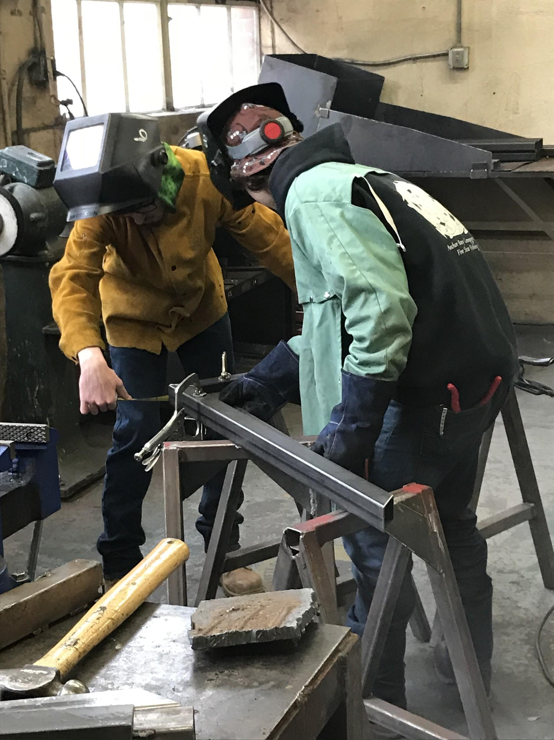
Welding
Grades 9-12
The welding class at John Swett teaches four welding process, thermal, and machine cutting processes, metal fabrication, blueprint reading, including welding symbols, and how to operate all shop tools and practice theses processes safely. Welding and Cutting is not just fun, but is a starting point for entry into the Welding trades, (lots of good paying jobs). You will learn the practical skills necessary for employment, and have fun doing it. What more can you ask for. Come join the fun, take the plunge, and see what it's all about.

Slide 22
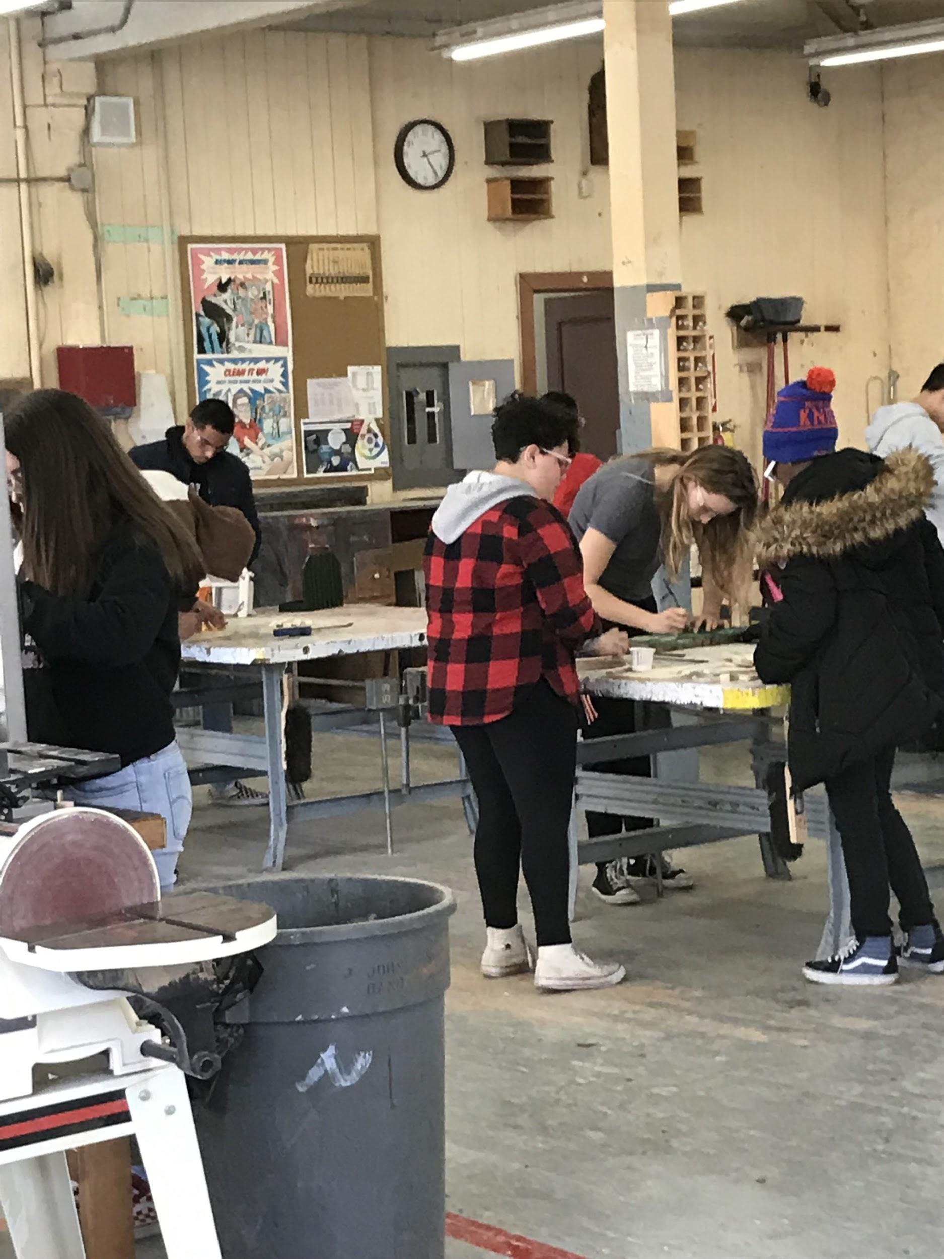
Woodshop
Grades 9-12
Our Woodshop class here at Swett is a project based class. It is a beginning woodworking class that teaches you how to safely use woodworking tools and machines, both hand held, and stationary. You will learn how to build projects using the knowledge that you have obtained. What you make, is yours to take. This is a very popular class, and fills up two periods quickly. You will gain practical knowledge of how to crosscut, and rip lumber to length and width. You will also learn how to plane wood to thickness, how to sand, glue, clamp, and then paint or stain your projects. The experience that many students have in this class has led them to return for a second, and even a third year. If you wish to come, and join the fun, you better sign up fast because the seats will not last.

